Slide 1
Hackathon 2025: Smarter Reconciliation and Anomoly Detection Using GenAI
sradg-dragon-team

Slide 2
Problem Statement & Solution approach
Problem statement:
we have to develop an end to end pipeline that accepts reconciliation details, current and historical data as input , outputs :
Anomaly detection results
Classification of detected summary
Break resolution summaries
Autonomously act on the break resolution
Solution Approach:
With help of python libraries (i.e pandas) have cleaned and preprocessed the raw historical data
We leveraged DeepNural network to find the the anomaly in the data based on historical data and different patterns in the data.
Used Classification ML model and LLM model (gemini) to classify the detected anomaly and generate a break resolution
summaries
If anomaly detected will create a JIRA issue and will send an email notification to the concerned team for human in the loop
Created one interactive user interface where user can upload there test data and get the result for better user experience

Slide 3
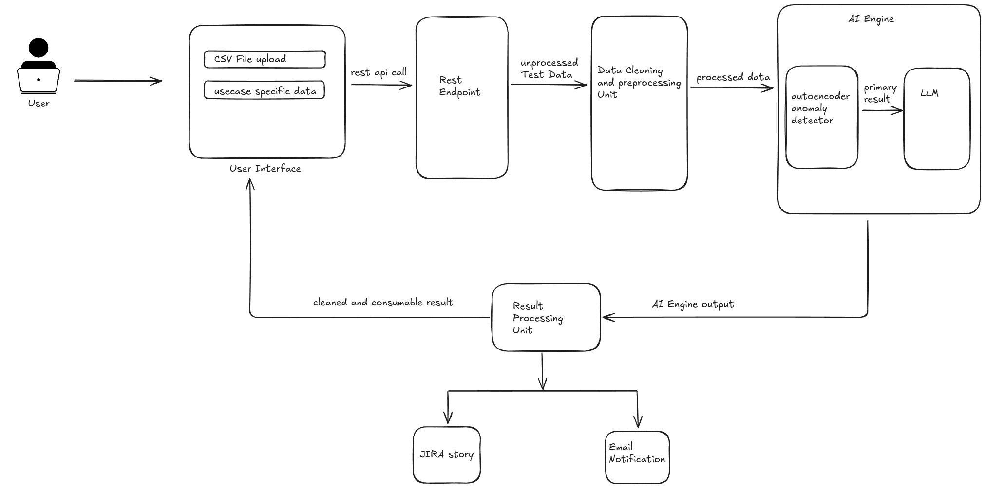
Smarter Reconciliation and Anomaly Detection Using GenAI Architecture

Slide 4
Result & Success Stories
With help of DeepNural Network algorithm we did achive an accuracy score of ~87% when tested on unseen test dataset
Implementing the combination of Classification algorithm and Large Language Model (LLM) we could able to correctly classify
~78% of test data to there respective break catagory on unseen test dataset.
Using Gemini model could able to correctly send break reasons and resolution summaries
Did implement end to end solution from taking the raw csv data to detection of anomaly and classification , break reason and resolution instruction
Implemented the notification and JIRA ticket creation for human in the loop

Slide 5
Smarter Reconciliation and Anomaly Detection Using GenAI- Benefits & Challenges
Benifits:
As an Agent or end user can pass the all the history data and current data . On basis of reading all the history data and pattern find the anomaly and comments , which will help to Agent or customer to get the mismatch data.
Catalyst Reconciliation scenario will help to remediate the anomaly
Challenges:
Unavailability of Training DataSet
LLM models free tier are not much capable of quality output generation

Slide 6
Challenges
Unavailability of Training DataSet
LLM models free tier are not much capable of quality output generation

